Slide 1

SOCIAL BUZZ ANALYTICS

Slide 2


Today's agenda
Project recap
Problem
The Analytics team
Process
Insights
Summary

Slide 3

Social Buzz is a fast growing social media organization and over the past 5 years.
Accenture has began a three month POC focusing on;
An audit of their big data practices
An analysis of their content categories that highlights the top 5 categories with the largest aggregate popularity.
Project Recap

Slide 4


Problem
Every day over 100,000 pieces of content
36500 pieces of content per year.

Slide 5



The Analytics team

Slide 6

Data Understanding
Process
1
2
Data Cleaning
Data Modelling
3
Data Analysis
4
5
Uncover Insights

Slide 7
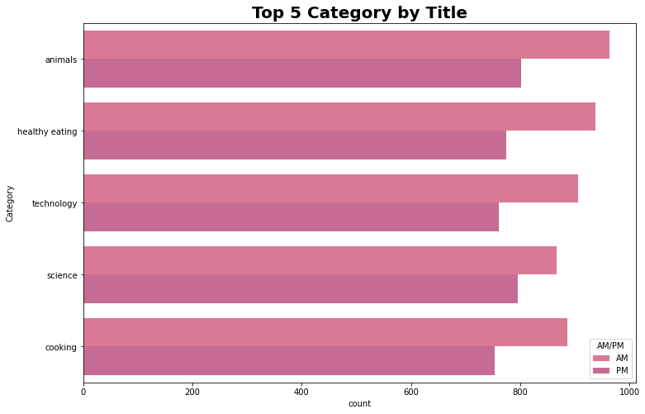

Insights

Slide 8
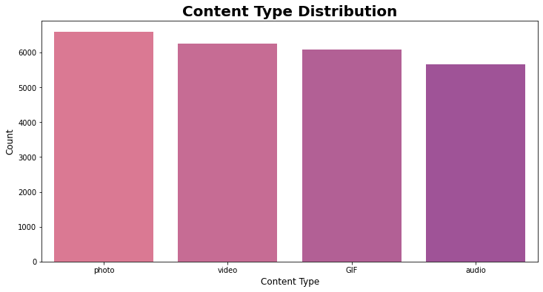

Slide 9
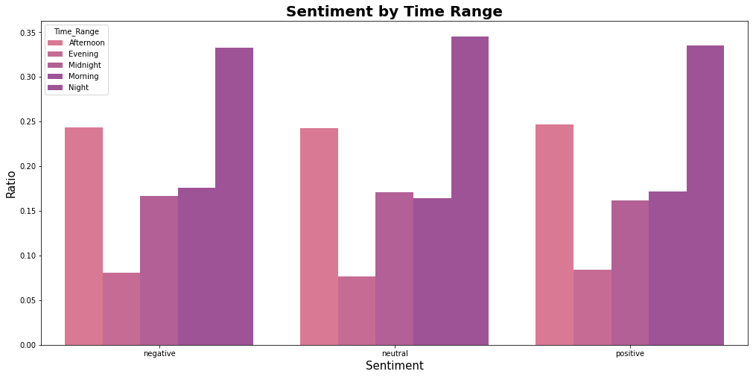

Slide 10

Animals and science are two of the most popular content categories, this shows that people enjoy “real-life” and “factual” content the most. So I would recommend that you keep creating more contents relating to these two categories.
Food is a common theme with the top 5 categories with “Healthy Eating” ranking as one of the highest. This may give an indication to the audience within your user base. You could use this insight to create a campaign and work with healthy eating brands to boost user engagement.
Summary

Slide 11

Thank you!
ANY QUESTIONS?

